Slide 1
Comparing Proof Systems for Linear Real Arithmetic Using LFSC
University of Iowa
New York University
Andrew Reynolds
September 17, 2010
MVD 2010

Slide 2
Acknowledgements
University of Iowa
New York University
University of Iowa
Andrew Reynolds, Cesare Tinelli, Aaron Stump
New York University
Liana Hadarean, Yeting Ge, Clark Barrett
MVD 2010

Slide 3
Motivation for this work
University of Iowa
New York University
SMT solvers are difficult to verify
Code may be complex (10k+ loc)
Code is subject to change
Alternatively, solvers can justify answers with proofs
There is need for third party certification
Must ensure that proof is valid
MVD 2010

Slide 4
Certifying SMT Solver’s Answers
University of Iowa
New York University
For “satisfiable”:
Provide a satisfying assignment
For “unsatisfiable”:
Provide a proof of unsatisfiability
MVD 2010

Slide 5
Architecture
University of Iowa
New York University
Solver
sat
unsat
Assignment
Proof of Unsatisfiability
.....
Proof Checker
Proof Valid
Proof Invalid
MVD 2010

Slide 6
Proof Checking: Challenges
University of Iowa
New York University
Flexibility
Different solvers have different needs
Solvers can change over time
Many different theories
Speed
Practical for use with solvers
Measured time against solving time
MVD 2010

Slide 7
Overview
University of Iowa
New York University
Certification of proofs in QF_LRA
Use LFSC for proof checking
Experiments with QF_LRA proof systems
Examine declarative vs computational
Use CVC3 for proof generation
MVD 2010

Slide 8
Proof Checking in LFSC
University of Iowa
New York University
Edinburgh Logical Framework (LF) [Harper et al 1993]
Based on type theory
Meta framework for defining logical systems
LF with side conditions (LFSC) [Stump et al 2008]
Meta-logical proof checker
Side Conditions
Support for Integer, Rational arithmetic
If proof term type-checks,
Then proof is considered valid
MVD 2010

Slide 9
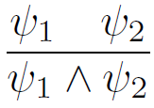
Example proof rule
University of Iowa
New York University
(declare and_intro
(! f1 formula
(! f2 formula
(! p1 (proof f1)
(! p2 (proof f2)
(proof (and f1 f2)))))))
MVD 2010

Slide 10
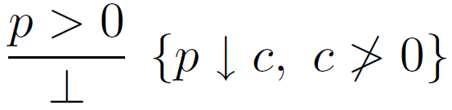
Proof rule with side condition
University of Iowa
New York University
(declare ineq_contradiction
(! p poly
(! p1 (proof (> p 0))
(! s (^ (is_positive (simplify p)) ff)
false))))
MVD 2010

Slide 11
Proof rule with side condition
University of Iowa
New York University
Side conditions
Written in simply typed functional language
Most are concise (less than 10 loc)
MVD 2010

Slide 12
Proof rule with side condition
University of Iowa
New York University
(program simplify ((p poly)) real
(match p
((poly c' l')
(match (is_zero l')
(tt c')
(ff fail)))))
…
(^ (is_positive (simplify p)) ff)
MVD 2010

Slide 13
Why side conditions?
University of Iowa
New York University
Mirror high-performance solver inferences
More Efficient
Smaller Proof Size
Faster Checking time
Amount can be fine tuned
Fully Declarative
Fully Computational
MVD 2010

Slide 14
LFSC Optimizations [Oe et al 2009]
University of Iowa
New York University
Incremental Checking
Proof checking occurs while reading proof
Deferred Resolution
Efficient to check boolean inferences
Compiled Side Condition Code
Compiled instead of interpreted code
MVD 2010

Slide 15
Contributions of this work [2010]
University of Iowa
New York University
Demonstrate capabilities of LFSC
Flexibility in:
Handling new logic (QF_LRA)
Defining multiple proof systems for this logic
Developed LFSC signatures for QF_LRA
Instrumented CVC3 to produce proofs in system
Comparative analysis
MVD 2010

Slide 16
CVC3
University of Iowa
New York University
Refutation based prover for SMT
Support for many different logics
Integer/Real, Arrays, Data types, etc.
Support for quantifiers
Proof generation
Native format
MVD 2010

Slide 17
CVC3 to LFSC proofs
University of Iowa
New York University
CVC3
sat
unsat
CVC3 Proof of Unsatisfiability
…..
LFSC Proof of Unsatisfiability
LFSC
Did not modify CVC3 core
Translated CVC3 Proofs to LFSC
Opportunity to test different translations
…..
MVD 2010

Slide 18
Approaches
University of Iowa
New York University
Literal translation (Lit)
Mimics the structure of CVC3 proofs
Liberal translation (Lib)
Compacts portions of proof to side conditions
Limits compaction to QF_LRA theory lemmas
Aggressive Liberal translation (Lib-A)
Extends compaction to equality reasoning proof fragments
Declarative
Computational
Lit
Lib
Lib-A
MVD 2010

Slide 19

CVC3 Proofs
University of Iowa
New York University
Proof derives false from:
Input formulas
Theory Lemmas
i.e. ( x+1 > x )
Proof Rules
Many rules (100+)
Rewrite axioms
Mostly Declarative
MVD 2010

Slide 20
Compaction from CVC3 to LFSC
University of Iowa
New York University
Theory lemmas in QF_LRA
Ex: ¬( 2x>2y ) ∨ ¬( y>x+5 )
Proof of unsatisfiability from assumptions
MVD 2010

Slide 21
Compaction from CVC3 to LFSC
University of Iowa
New York University
Theory lemmas in QF_LRA
Ex: ¬( 2x>2y ) ∨ ¬( y>x+5 )
Can be done by finding set of coefficients
½*
1 *
2x > 2y
y > x + 5
x + y > y + x + 5
⇒
0 > 5
MVD 2010

Slide 22
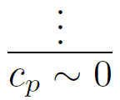
Compaction from CVC3 to LFSC
University of Iowa
New York University
LFSC proofs use polynomial formulas
Ex: Instead of 2x > 2y, (2x – 2y)↓ > 0
Proof of theory lemmas are always of the form:
Intuition: For each CVC3 rule, determine corresponding coefficient to multiply each premise by to obtain contradictory polynomial c_{p}
MVD 2010

Slide 23
Compaction from CVC3 to LFSC
University of Iowa
New York University
CVC3 rules mapped to polynomial operations
Applies to all proof rules for theory lemmas
However, not applicable to boolean portions
Compaction occurs because:
Condense redundant operations
Eliminate trivial subproofs, such as those involving only rewrite axioms
MVD 2010

Slide 24
Proof Compaction Example
University of Iowa
New York University
Theory lemma example:
½*
1 *
2x > 2y
y > x + 5
x + y > y + x + 5
⇒
0 > 5
MVD 2010

Slide 25
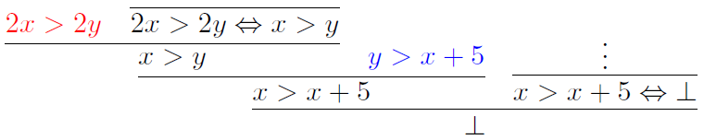
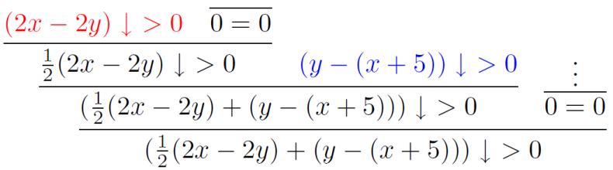
Proof Compaction step 1
University of Iowa
New York University
Map to operations on polynomials
MVD 2010

Slide 26
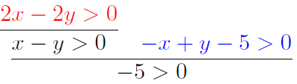
Proof Compaction step 2
University of Iowa
New York University
Remove redundant operations
MVD 2010

Slide 27
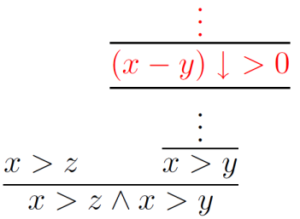
Aggressive Liberal translation
University of Iowa
New York University
Attempt to compact all theory inferences
When conversion gets stuck,
Switch to literal translation
Compact
Translation
Literal
Translation
MVD 2010

Slide 28
Experimental results
University of Iowa
New York University
Tested 201 unsatisfiable QF_LRA/QF_RDL benchmarks
Each solved ≤ 900s by CVC3
Proof generation ≤ 900s
Configurations
CVC3 native proof (CVC3)
Literal (Lit)
Liberal (Lib)
Aggressive Liberal (Lib-A)
MVD 2010

Slide 29
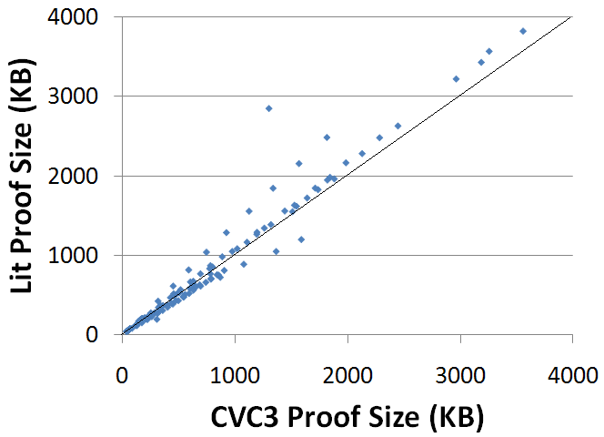
Proof size CVC3 vs Lit
University of Iowa
New York University
MVD 2010

Slide 30
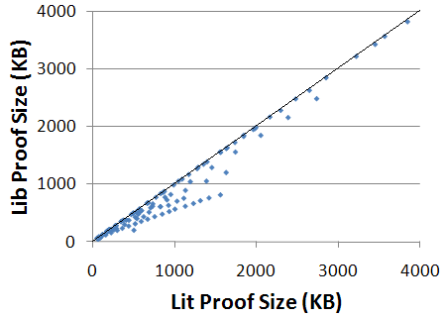
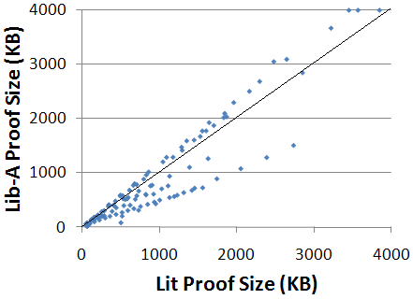
Proof size
University of Iowa
New York University
Lit vs Lib
Lit vs Lib-A
MVD 2010

Slide 31
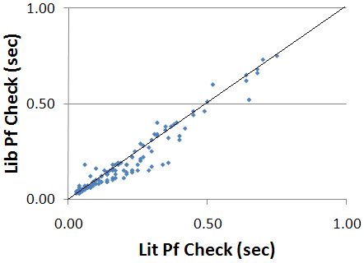
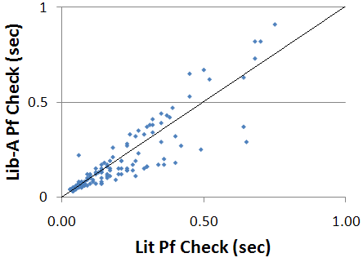
Proof checking time
University of Iowa
New York University
Lit vs Lib
Lit vs Lib-A
MVD 2010

Slide 32
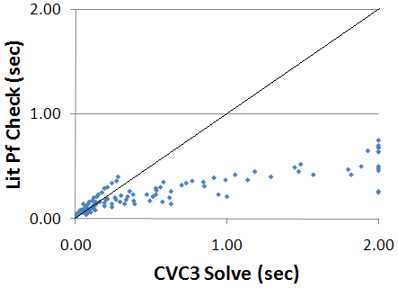

Proof checking vs Solving
University of Iowa
New York University
Solving vs Lit
Solving vs Lib
MVD 2010

Slide 33
Analysis
University of Iowa
New York University
Theory content 8.3% on average
For theory heavy benchmarks
Lib compresses proof sizes 32%
Lib-A compresses proofs sizes 35% (1% overhead on non-theory benchmarks)
Lib is the most effective method overall with an average compression of 17%
MVD 2010

Slide 34
Analysis continued
University of Iowa
New York University
When isolated to theory component
Lib compresses proof sizes factor of 5.34
Lib improves proof checking factor of 2.33
Overall, Lib proof checking is factor of 9.4 faster than solving time
MVD 2010

Slide 35
Conclusions
University of Iowa
New York University
LFSC is a pragmatic approach to proof checking
Efficient
Checking times fast w.r.t. solving
Trustworthy
Small/not complex side condition code
Clear definition of trusted components
Flexible
Signature is separate from checker
Effective for different proof systems
MVD 2010

Slide 36
Future work
University of Iowa
New York University
Integration with CVC4
New decision procedures
New logics (arrays etc.)
Public release of LFSC
Tool for signature creation
LFSC proof generation library
Interpolant generating proofs
MVD 2010

Slide 37
University of Iowa
New York University
Questions?
MVD 2010

